Slide 1
Docker
Nejarul Islam
Anuska Ghosh
Rahul Biswas

Slide 2
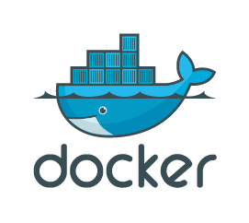
What is Docker?
Docket is an open platform for developing,shipping and running applications
Dev → Test → Production

Slide 3
Why Docker(problem statement)?
No environment issues
Fast deployment
Lightweight
Easy scaling

Slide 4
What is Docker Image?
Read-only template
Contains code, dependencies, runtime
Built using Dockerfile

Slide 5
What is Docker Container?
Running instance of image
Executes application
Isolated environment

Slide 6
Image vs Container(Confused question)
Image = Blueprint
Container = Running app
Image is static, container dynamic

Slide 7
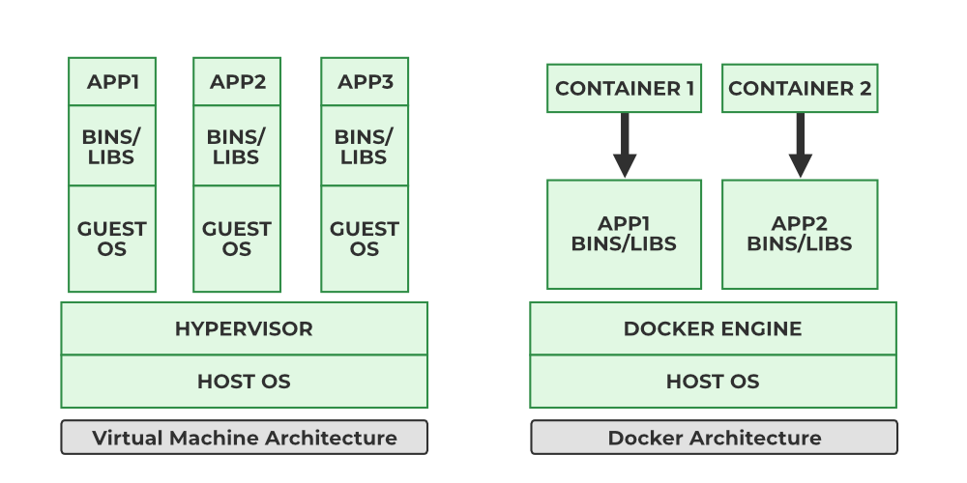
Docker vs VM
Docker shares host OS
VM has full OS
Docker is fast, VM is slow
Docker is lightweight

Slide 8
Docker Volumes
Used for data persistence
Data not lost after container stops
Stored outside container

Slide 9
Types of Volumes
Named volumes
Bind mounts

Slide 10
Dockerfile
Script to build image
Contains instructions

Slide 11
Dockerfile Example
FROM openjdk:17 //Base Image
WORKDIR /app // Working Directory
COPY app.jar app.jar //Copy File
EXPOSE 8080 //exposing the port
ENTRYPOINT java -jar app.jar //startup file

Slide 12
Basic Commands of Docker
Docker can be used in gui mode using Docker desktop.(only for windows, mac)
Docker cli gives versatility as it can run in any os
Basic commands:-
To Pull images from any repository is :-
docker pull repo_address/image_name:tag_version
Default repo_address is https://hub.docker.com/_/.
Default version is latest.
To display all the images in local file system:-
docker images

Slide 13
Basic Commands of Docker
To show running images/ Container:-
docker ps
… -a :- this shows all container (running or stopped)
To run an image :-
docker run image_name:tag_version
We can also run multiple images with different versions without any conflicts.
… -d :- using this tick , container starts in detached mode
… -- name <new_name> :- Assigns a new name to the container.
To start or stop or restart a container:-
docker stop <containter_id>/<container_name>
docker start <containter_id>/<container_name>

Slide 14
Basic Commands of Docker
Deletion Operations:-
docker rm <container_id>/<container_name>:-
This removes the container(container must be stopped)
docker rmi <image_name>:-
This removes the image
No container should be present with this image
Debug Operation:-
docker logs <container_id>/<container_name>:-
Display logs
docker exec –it <container_id>/<container_name> /bin/bash :- opens terminal of container. –it stands for interactive terminal. Sometimes it is shell(sh) not bash.

Slide 15
Docker Network
Host port vs Container port:
Two container can open same port
Two same port cannot be opened by host
We need to bind container port with host port to access containers from outside.
docker run –p<host_port:container_port> :- binds port
Host
P:5000
P:5001
Container 1
P:5000
Container 2
P:5000

Slide 16
Docker Network
Isolated docker network.
Containers in same network can communicate without port mapping, only by name.
Outsiders will need port number.
name
Localhost:port
mongo
Node
Mongo express

Slide 17
Docker Network
Commands:-
docker network create <network_name>:-
Creates a new bridge network.
docker run --network <net_name> <img_name >:-
Assigns a container to a network while starting.
Special networks :-
Host network:-
docker run --network host <img_name>:- assigns the container to the host network with same ip.
None network:-
Docker run --network none <img_name>:- creates a complete isolation, best of offline processing.

Slide 18
Docker Compose
Helps to configure containers much easier than docker run.
Orchestrate containers in a single node system while kubernatics can do this in multi node environment with load balancing.
Run config cont 1
Run config cont 2
A file(.yaml)
Run config cont 3

Slide 19
Docker compose
docker run -d --name mongodb -p 27017:27017 mongo:latest
Same as:-
services:
mongodb:
image: mongo:latest
ports: - "27017:27017"

Slide 20
Docker compose
Basic structure :-
services:
container_name1:
image: image_name
ports:
- 80:80
environment:
- username:
networks:
-somenet
networks:
-somenet

Slide 21
Docker compose
To start a compose file:-
docker-compose –f file_name.yaml up:-
This will start multiple container with all configuration settings and a default bridge network.
To stop a compose file:-
docker-compose –f file_name.yaml down:-
This will remove all the containers and along with the network.

Slide 22
ElK compose
Elasticsearch is a distributed, RESTful search and analytics engine capable of solving a growing number of use cases.
Logstash is an open source data collection engine with real-time pipelining capabilities. Logstash can dynamically unify data from disparate sources and normalize the data into destinations of your choice.
Kibana is an open source analytics and visualization platform designed to work with Elasticsearch.

Slide 23
ElK Compose
ports:
- "5601:5601"
environment:
- ELASTICSEARCH_HOSTS=http://elasticsearch:9200
depends_on:
elasticsearch:
condition: service_started
networks:
- elk
logstash:
image: logstash:9.3.2
container_name: logstash
restart: always
ports:
- "5000:5000"
depends_on:
- elasticsearch
networks:
- elk
networks:
elk:
driver: bridge
Docker compose file for elk:
services:
elasticsearch:
image: elasticsearch:9.3.2
container_name: elasticsearch
restart: always
ports:
- "9200:9200"
- "9300:9300"
environment:
- discovery.type=single-node
- ES_JAVA_OPTS=-Xms512m -Xmx512m
networks:
- elk
kibana:
image: kibana:9.3.2
container_name: kibana
restart: always

Slide 24
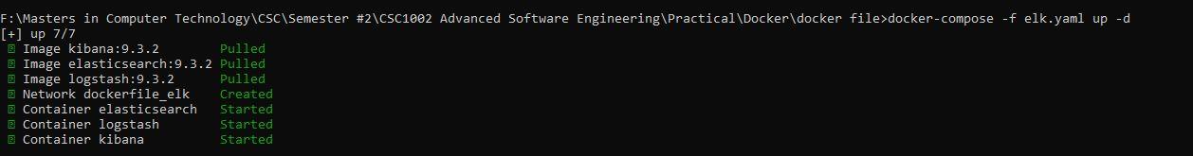
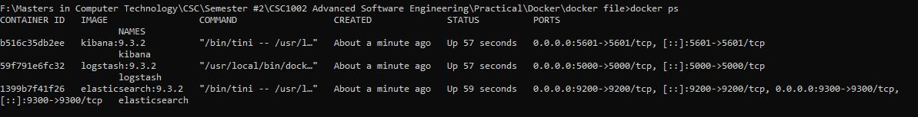
ElK Compose
Running docker compose
Containers after starting

Slide 25
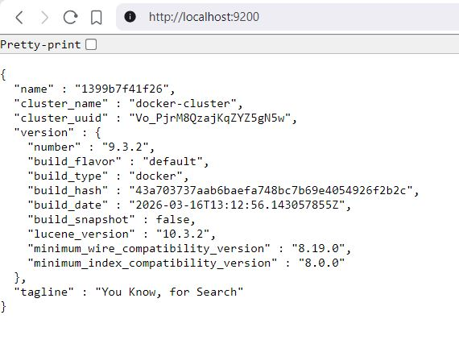
ElK Compose
Testing for elastic search

Slide 26
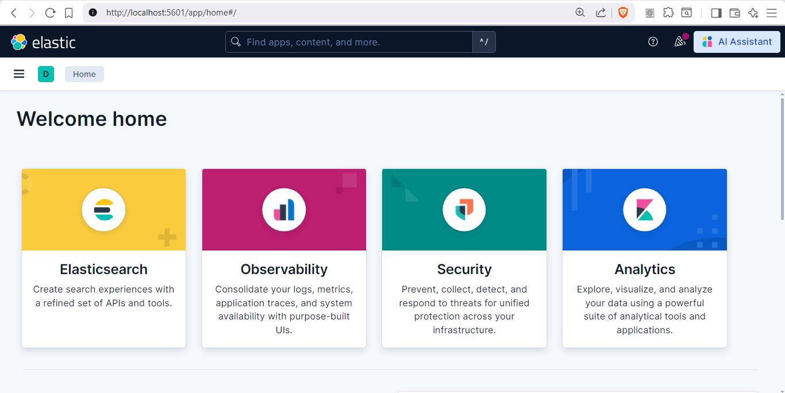
ElK Compose
Testing for kibana

Slide 27
THANK YOU

